Slide 1
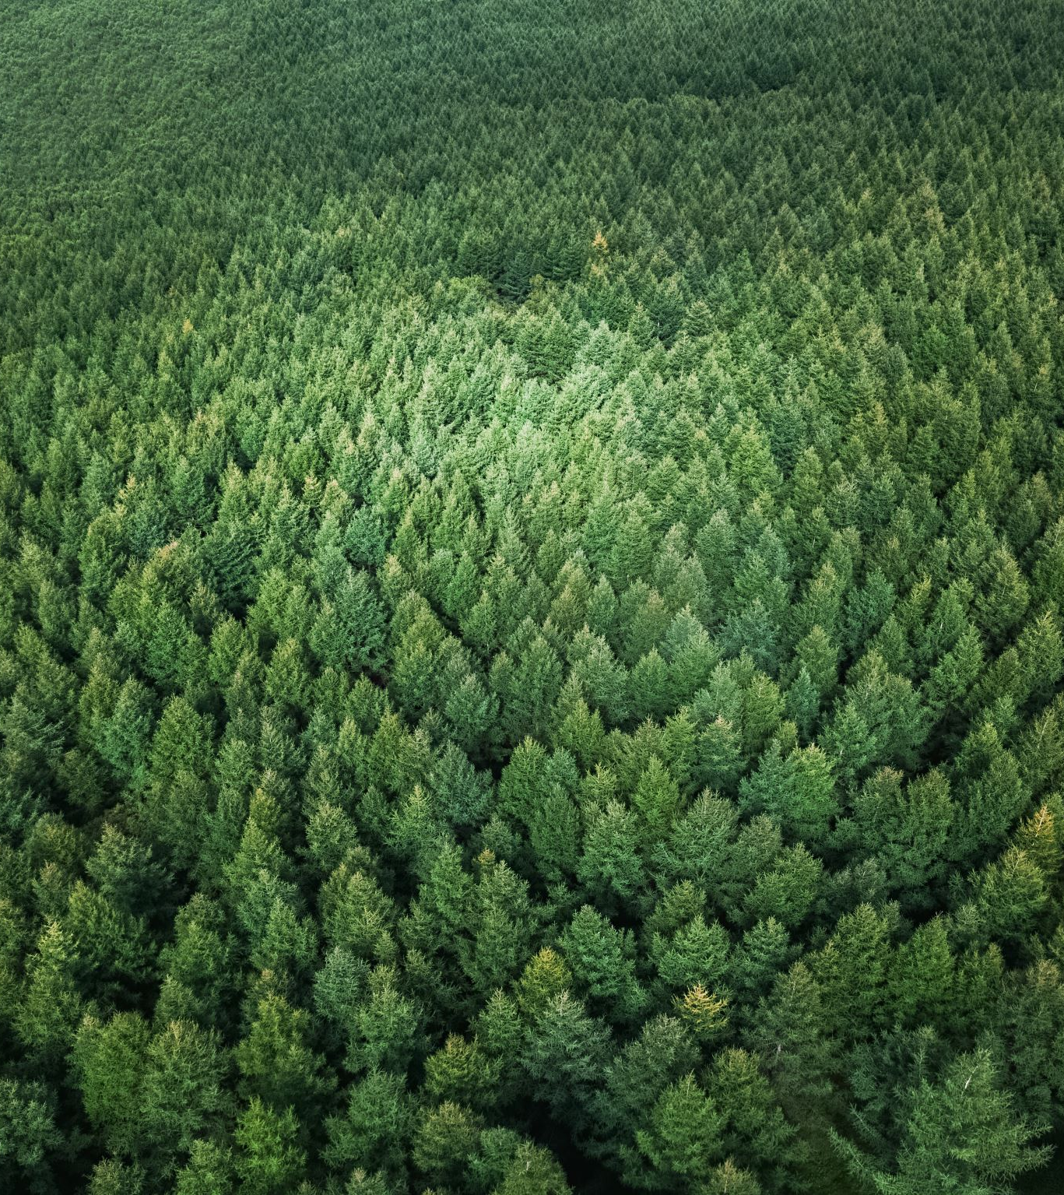
Random Forest Classifier

Slide 2
Random Forest Classifier
Random Forest is one of the most popular and commonly used algorithms by Data Scientists. Random forest is a Supervised Machine Learning Algorithm that is used widely in Classification and Regression problems.
It builds decision trees on different samples and takes their majority vote for classification and average in case of regression.

Slide 3
How does the Random Forest algorithm work?
Step 1: The algorithm select random samples from the dataset provided.
Step 2: The algorithm will create a decision tree for each sample selected. Then it will get a prediction result from each decision tree created.
Step 3: Voting will then be performed for every predicted result. For a classification problem, it will use mode, and for a regression problem, it will use mean.
Step 4: And finally, the algorithm will select the most voted prediction result as the final prediction.

Slide 4
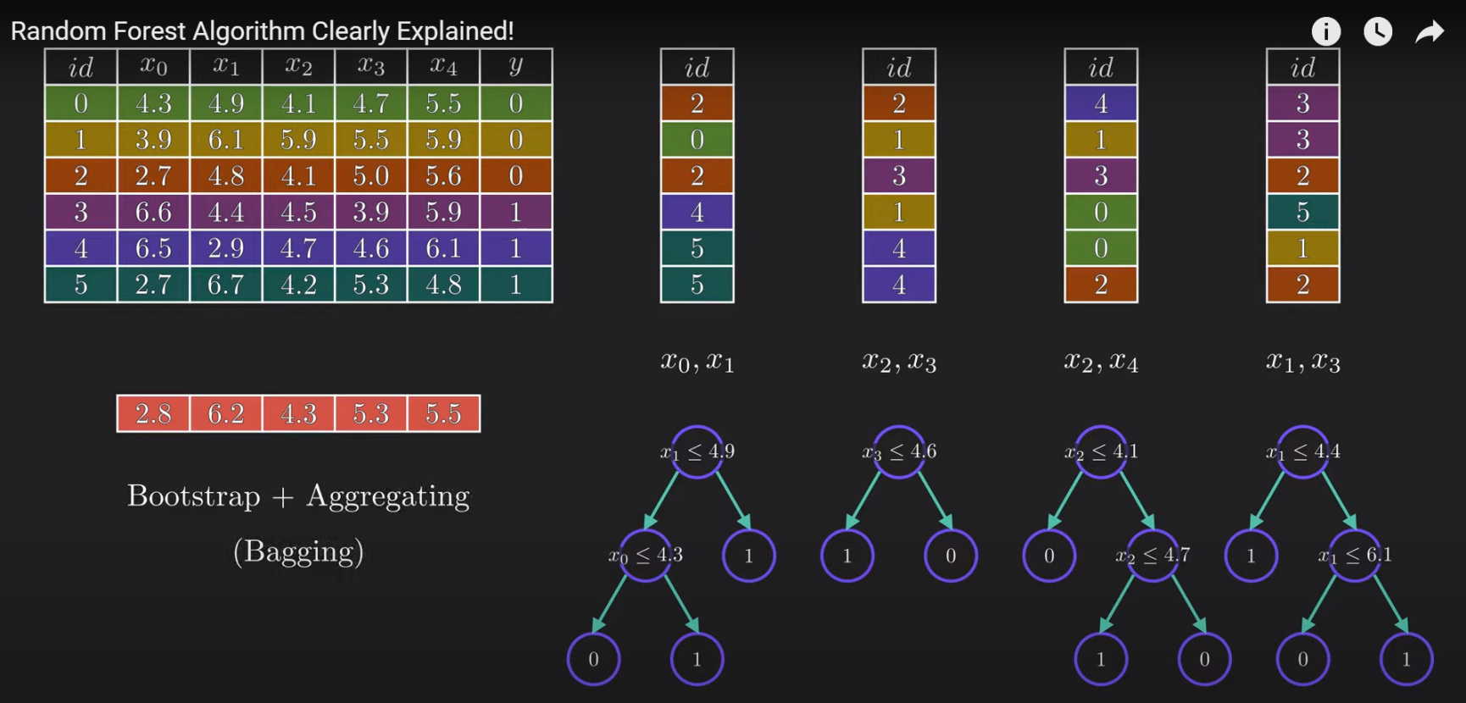
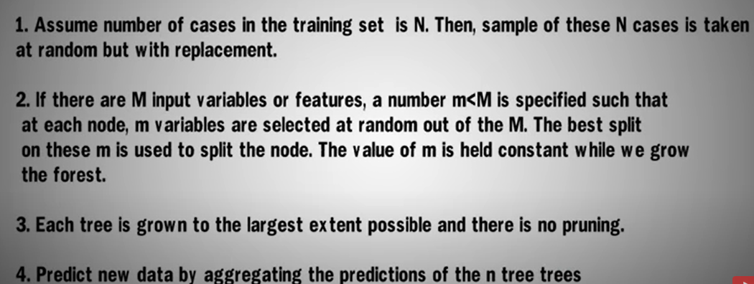
Random Forest PseudoCode
By sampling with replacement, means some of the data points may be repeated in each new training data set.

Slide 5
How does the Random Forest algorithm work?
It uses bagging and feature randomness when building each individual tree to try to create an uncorrelated forest of trees whose prediction by committee is more accurate than that of any individual tree.
Random forest tends to combine hundreds of decision trees and then trains each decision tree on a different sample of the observations. The final predictions of the random forest are made by averaging the predictions of each individual tree.

Slide 6
Bagging
Bagging (Bootstrap Aggregation) — Decisions trees are very sensitive to the data they are trained on — small changes to the training set can result in significantly different tree structures.
Random forest takes advantage of this by allowing each individual tree to randomly sample from the dataset with replacement, resulting in different trees. This process is known as bagging.

Slide 7
Advantages
Handle the missing values and maintains accuracy for missing data. Missing values are substituted by the variable appearing the most in a particular node.
The decision trees tend to overfit to the training data, but random forest can mitigate that issue by averaging the prediction results from different trees.
Handle large dataset with high dimensionality.
Among all the available classification methods, random forests provide the highest accuracy.
Random Forest is very versatile and can be used in both regression and classification tasks. It can also handle all binary, categorical, and numerical features.

Slide 8
Disadvantages
Black Box Approach: You have very little control on what the model does.
No understanding of model calculations, everything calculated behind the screen and have no manual intervention.
It consumes more time compared to a decision tree algorithm.
The decision tree in a forest cannot be pruned for sampling (no control on model).
Good job at classification but not good as for Regression.

Slide 9
Important Facts
How many features to be considered in Random Forest?
Researchers says that the value close to the log or sqrt of the total number of features is the best number of features.
Does it work differently for Classification and Regression?
For classification, the measure of impurity is either the Gini impurity or the information gain/entropy.
For regression the measure of impurity is variance.
Does it work differently for Classification and Regression?
For classification, the measure of impurity is either the Gini impurity or the information gain/entropy.
For regression the measure of impurity is variance.
Is Feature Selection possible with Random Forest Classifier?
The random forest algorithm can also help you to find features that are important in your dataset. It lies at the base of the Boruta algorithm, which selects important features in a dataset

Slide 10
Questions
What are Ensemble Methods?
Ensemble methods is a machine learning technique that combines several base models in order to produce one optimal predictive model.
Random Forest is a type of ensemble method.
How does Random Forest handle missing values?
Fill in the missing values with the median (for numerical values) or mode (for categorical values). This method will brush too broad a stroke for datasets with many gaps and significant structure.
How would you improve the performance of Random Forest?
Using a higher quality dataset and feature engineering. Using too many features and data are not good for the model so sometimes it is important to perform some feature reduction too.
Tuning the hyperparameters of the algorithm.
Is Feature Selection possible with Random Forest Classifier?
The random forest algorithm can also help you to find features that are important in your dataset. It lies at the base of the Boruta algorithm, which selects important features in a dataset

Slide 11
Feature Selection from Random Forest
First
import pandas as pd from sklearn.ensemble import RandomForestClassfier from sklearn.feature_selection import SelectFromModel
sel = SelectFromModel(RandomForestClassifier(n_estimators = 100)) sel.fit(X_train, y_train)
Second
# check Important features
feature_importances_df = pd.DataFrame(
{"feature": list(X.columns), "importance": classifier.feature_importances_}
).sort_values("importance", ascending=False)
# Display
feature_importances_df

